Slide 1
Dataman’s DM Tracker
www.dataman.in
Shashank Srivastava
Manager –Business Development
Dataman
Aug 7, 2015

Slide 2

Agenda
Agenda :
Dataman Corporate Overview
DM Tracker Showcase
Thank you !
Dataman Corporate Overview
Capability Showcase
Ce OE Discussion
Q&A

Slide 3
The Company
Founded in 1990 in India
  4 distributed development centers
  Presence in USA, Europe and India
  Focus on organic growth
Offerings
  Top-notch services
  Leading edge products
Financially Rock-solid
  Over 35% Growth in 2015
  Significant cash reserves & zero debt
  Strong focus on fundamentals
Delivery Capability
  Onsite-offshore model
  Multiple delivery channels
  Focus on quality processes
  High level of technical skills & Domain competency
People
  Skilled and Dedicated Work Force
  Strong Leadership
  Over 150+ strong team
Clients
  Over 5000
  Spread in 140 Cities
  Covering 4 Countries
Infrastructure
  State-of-the-art & fail safe
  Disaster recovery & Business continuity
Notes:
Dataman was founded as a U.S. Corporation in the San Francisco Bay Area, California in 1993 by Mani Subramanian, Founder-Chairman & CEO. Mani is an Engineer and MBA by profession who immigrated to the United States in 1992.
Dataman is a global software products and services company with operations in the USA, the UK, Asia Pacific, and South Africa with distributed Offshore Development Centers in India at Bangalore and Chennai. We have made considerable progress over the last 11 years since our inception. Our revenue run rate for the fiscal year 2003 is US $59+ Million with more than 1800 Datamanians spread across the globe.
With hardly $150,000 in start-up capital, Mani - the former president of Wipro Systems set out to create a new-generation software-solutions company. He was of course, backed by solid management experience of around 22 years, first at the Tata Group, where he expanded its IT services into other countries, and later at Wipro, where he increased revenue more than 400 percent in 3 years. Mani’s dream is to create an enduring and long lasting global IT Institution, which has the ability to create leaders and affect the lives of people over generations.
For a company that’s only a decade old, we achieved remarkable results in successfully adopting industry standard processes and quality levels. We benchmark ourselves against the world’s best IT companies and ensure that we rank among the best. A brief look at our certifications, and the rapidity with which we matured our processes to meet world-class standards proves our ability and desire to provide world-class service to our customers.
The processes adopted by Dataman are certified to operate as per SEI CMM Level 5 and ISO 9001 standards. In addition Dataman’s infrastructure is certified to ISO 17799 standards, and its Human Resource management is accredited to pCMM Level 3.

Slide 4
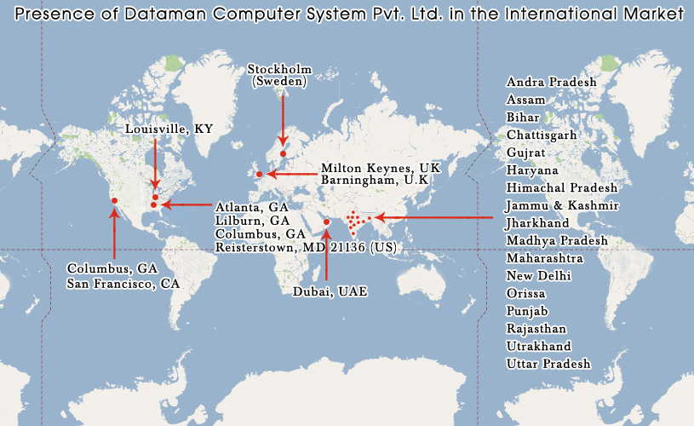
The Clients –Geographically
Notes:
Dataman was founded as a U.S. Corporation in the San Francisco Bay Area, California in 1993 by Mani Subramanian, Founder-Chairman & CEO. Mani is an Engineer and MBA by profession who immigrated to the United States in 1992.
Dataman is a global software products and services company with operations in the USA, the UK, Asia Pacific, and South Africa with distributed Offshore Development Centers in India at Bangalore and Chennai. We have made considerable progress over the last 11 years since our inception. Our revenue run rate for the fiscal year 2003 is US $59+ Million with more than 1800 Datamanians spread across the globe.
With hardly $150,000 in start-up capital, Mani - the former president of Wipro Systems set out to create a new-generation software-solutions company. He was of course, backed by solid management experience of around 22 years, first at the Tata Group, where he expanded its IT services into other countries, and later at Wipro, where he increased revenue more than 400 percent in 3 years. Mani’s dream is to create an enduring and long lasting global IT Institution, which has the ability to create leaders and affect the lives of people over generations.
For a company that’s only a decade old, we achieved remarkable results in successfully adopting industry standard processes and quality levels. We benchmark ourselves against the world’s best IT companies and ensure that we rank among the best. A brief look at our certifications, and the rapidity with which we matured our processes to meet world-class standards proves our ability and desire to provide world-class service to our customers.
The processes adopted by Dataman are certified to operate as per SEI CMM Level 5 and ISO 9001 standards. In addition Dataman’s infrastructure is certified to ISO 17799 standards, and its Human Resource management is accredited to pCMM Level 3.

Slide 5

KEY CUSTOMERS
Notes:
We are flexible and always willing to invest in our customers, to understand their business needs and formulate their technology strategies. Our customers choose us because of our commitment to delivering tangible value, focus on long-term relationship building, adherence to unmatched quality standards, willingness to take accountability, and flexibility to provide innovative solutions. Our expansion at Honeywell, Orange, TJX, Scottish Life, Staples, Teradyne, Unisys, WellsFargo, Helphire and many others is directly attributable to the superior quality of our work and our ability to provide fundamental business benefits through our mature onsite/offshore model.
We have successfully provided world-class software solutions to Fortune 500 companies over the last decade leveraging a number of technology standards and platforms including Mainframe, Client/Server, Intranet/Internet, and Wireless. Our experience and expertise cuts across customers in the Financial Services, High Technology, Manufacturing, Retail, Telecommunications and Transportation sectors.

Slide 6

Dataman’s Product Range
Health Care Products for Hospitals, Clinics, Diagnostics Center – 700+ Installations
Hospitality and Entertainment Industry Products – 800+ Installations
Academic Software Product – for Professional Colleges, University, Degree Colleges and Schools 300+ Installations
Supply Chain Products – Nearly 2000 Installations
For Construction and Real Estate ERP – 50+ Installations
Real-Builder

Slide 7
Dataman’s – DM Tracker www.locationtracker.in

Slide 8
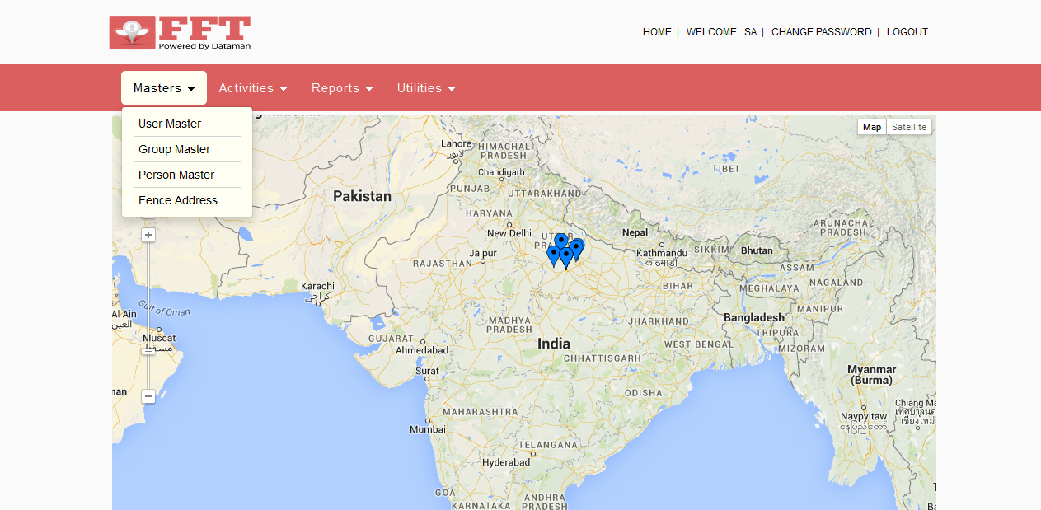
Home Screen
Here, on the India Map, The Blue Icons are shown which represent active users whose location data is being recorded through the DM Tracker Solution. Clicking on any of these Blue Icons will show the location & route coverage for the user.

Slide 9
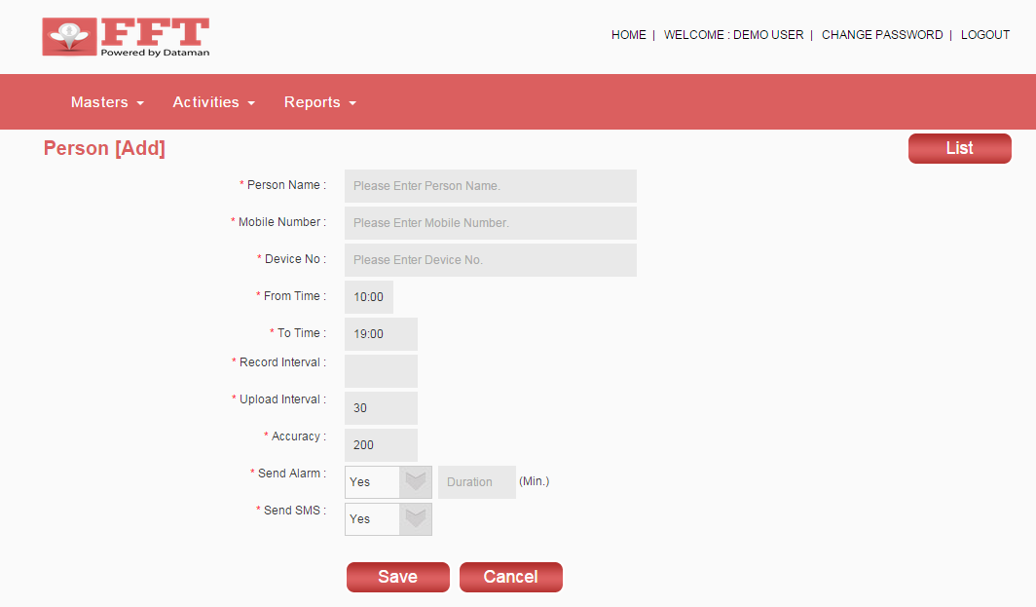
Add Person
Here, the Person Details can be Added.

Slide 10
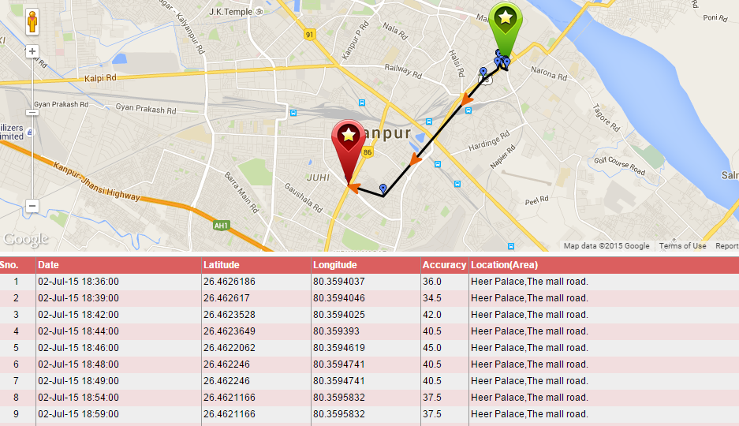
Today's Location
This will present you with the entire location route coverage for the user in the form of map as well as in tabular format.

Slide 11
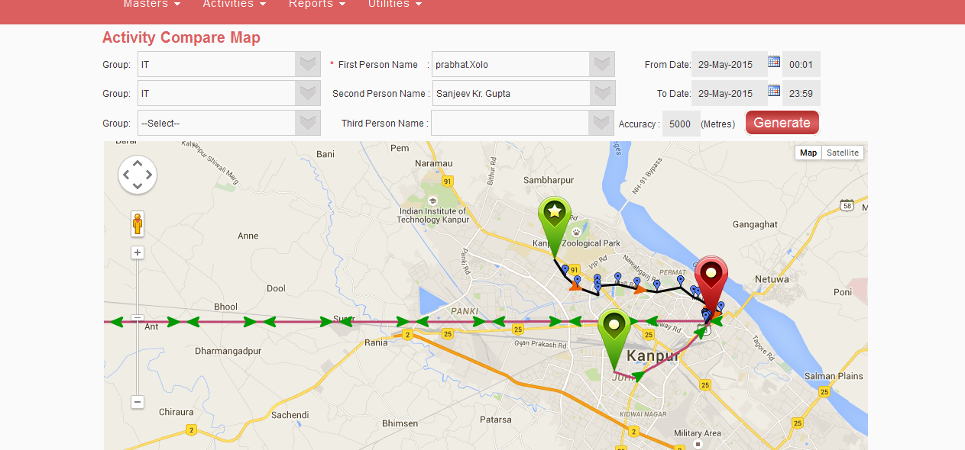
Activity Compare Map
The Activity Compare Map allows you to simultaneously view and compare the route coverage for two or three users at a time. With this, you can see how they have traversed the route allotted to them. It also helps you to come out with optimum route plan for your users.

Slide 12
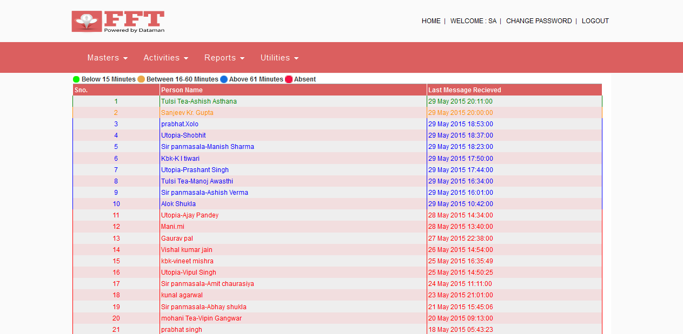
User's Dashboard
It is the User's Dashboard . All user’s has shown here, Green Colored Users are the Ones for which the last Location Message Received is below 15 Minutes. Orange Colored Users, for which last location Message received was above 16 Min to 60 Minutes. Blue Colored users, for which last location message received above 60 minutes. Red Colored users have absent.

Slide 13
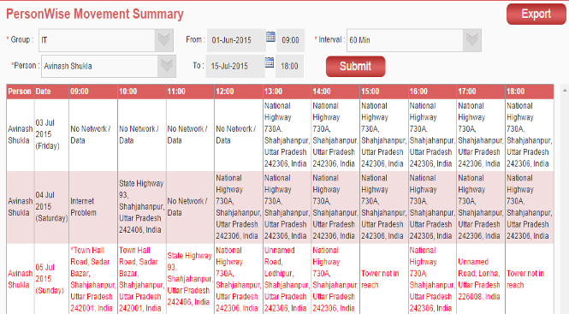
Movement Summary Person Wise
The Movement Summary Person Wise Report furnishes movement summary of the selected person in the form of location details for the specified period (date range) and selected time interval.

Slide 14
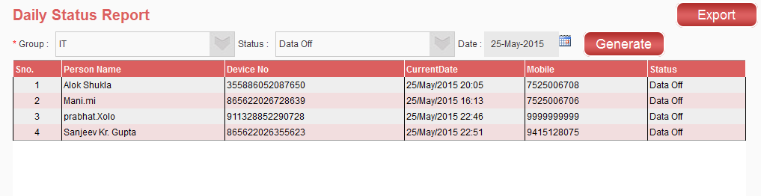
Daily Status Report
The Daily Status Report provides Status information such as GPS Off, Data Off, or Data Not Received for users belonging to a particular group on a day to day basis. The report furnishes details such as person name, device number, current date, mobile number, and status information.

Slide 15
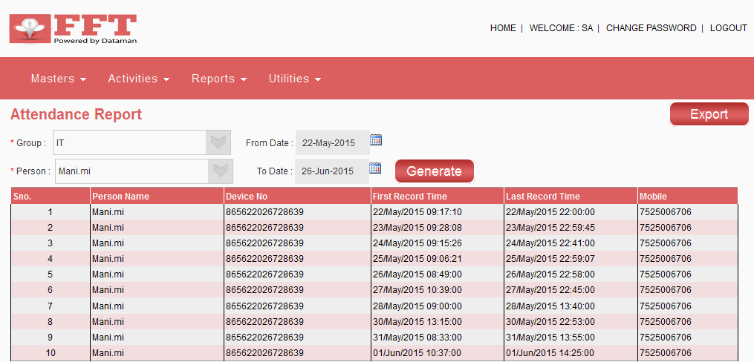
Attendance Report
Attendance Report furnishes first record time and last record time when location data is fetched and stored onto the server for a specific user for the chosen date(s).

Slide 16
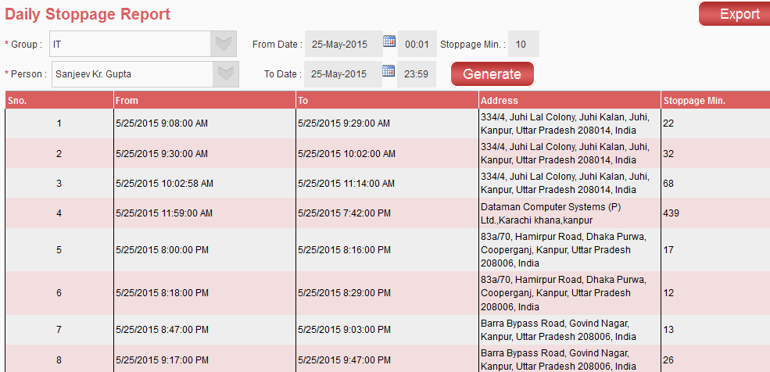
Daily Stoppage Report
Daily Stoppage Report is used to get stoppage time details for a user on a day to day basis. It gives you the date, time, address details and stoppage time duration (in minutes) when a user is stationed at a particular location.

Slide 17
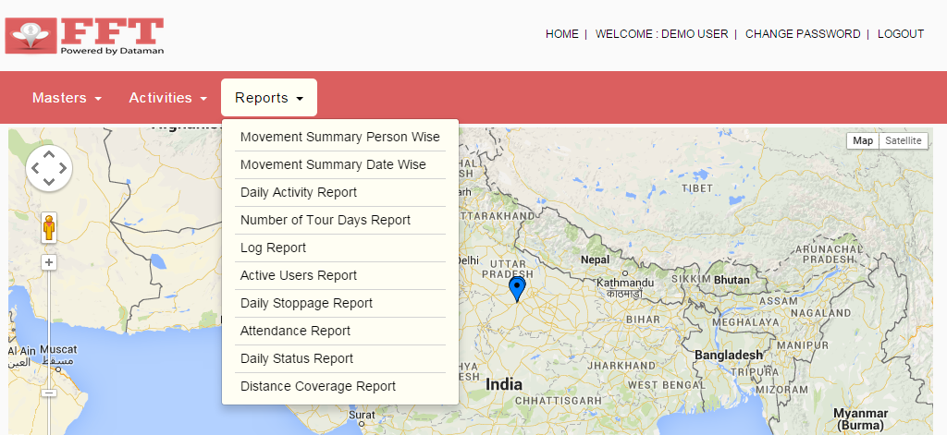
Types of Report:
Below are Ready to Excel import Reports ,so you can use it for your Internal Company Database.

Slide 18

Thank You!

